Slide 1

Flipkart Products analysis
Submitted by
SWATHI VANDANA

Slide 2
Problem Statement:
To analyze variation of different dimensions of Flipkart E-Commerce site data.

Slide 3




Tools used:
Talend
Cloudera
Hive
Data bricks

Slide 4
Dataset Description:
There are 14 Columns in Dataset.
uniq_id, crawl_timestamp, product_url, product_name, product_category_tree, pid, retail_price, discounted_price, image, is_FK_Advantage_product, description, product_rating, brand and number_of_reviews.
Dataset contains 20,000 rows.
This is a pre-crawled dataset, taken as subset of a bigger dataset (more than 5.8 million products) that was created by extracting data from Flipkart.com.

Slide 5
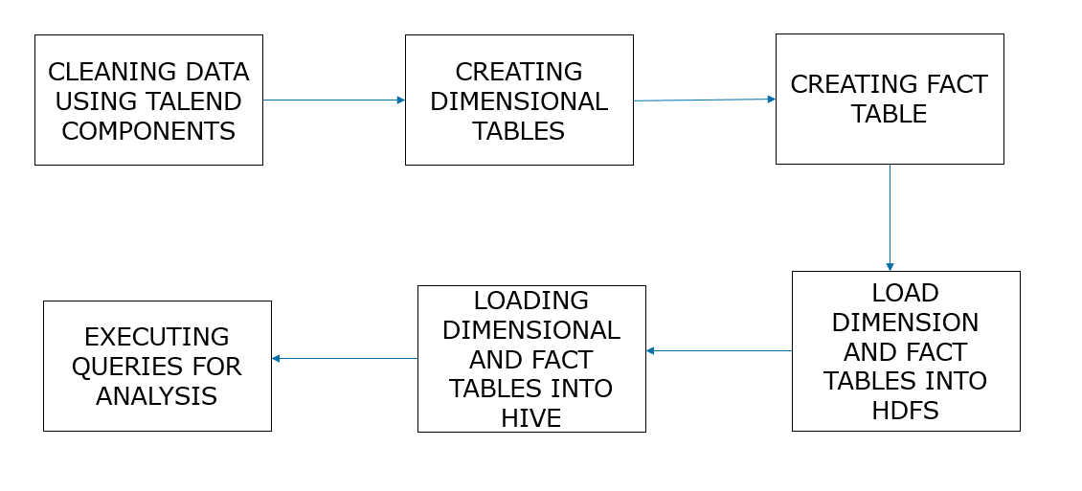
Flow chart:

Slide 6
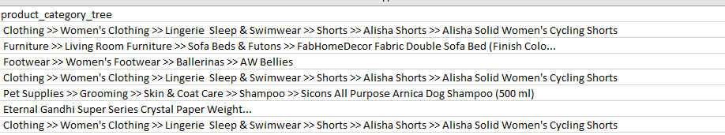
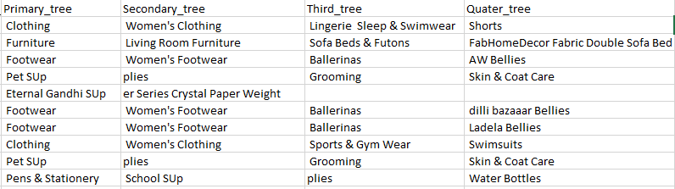
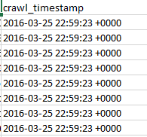
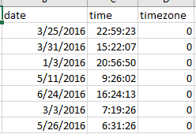
Data cleaning:

Slide 7
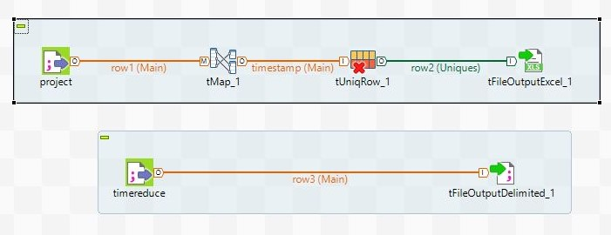
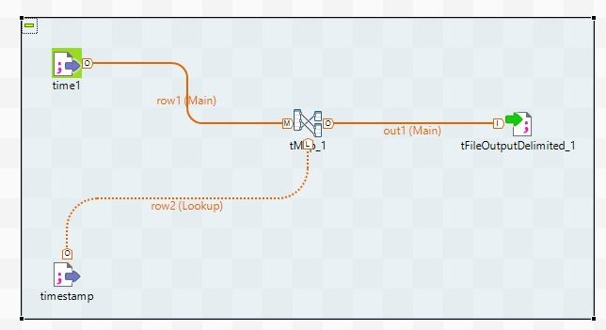
Data cleaning and creating dimensions and fact tables using Talend:

Slide 8
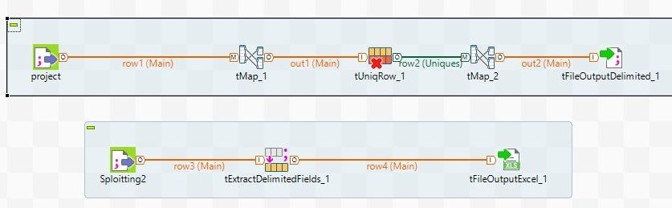
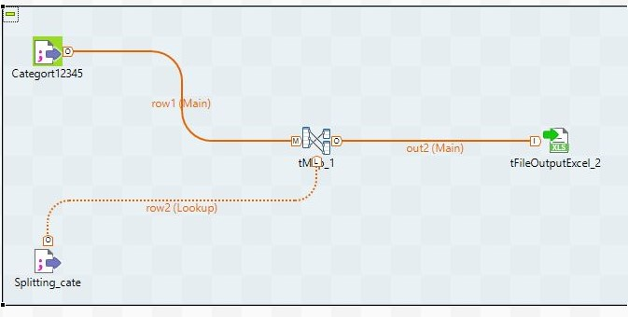
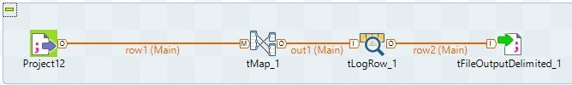

Slide 9
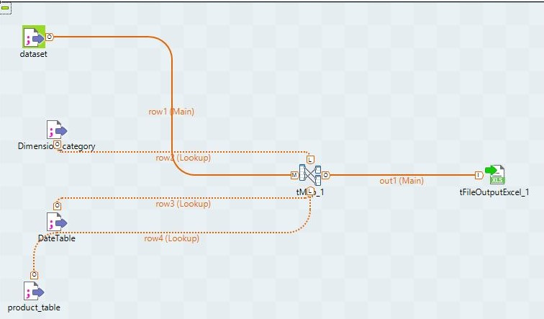
Fact table created in talend:

Slide 10
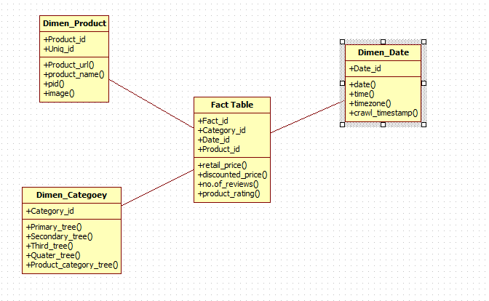
Data model:

Slide 11

Loading data in hdfs:

Slide 12
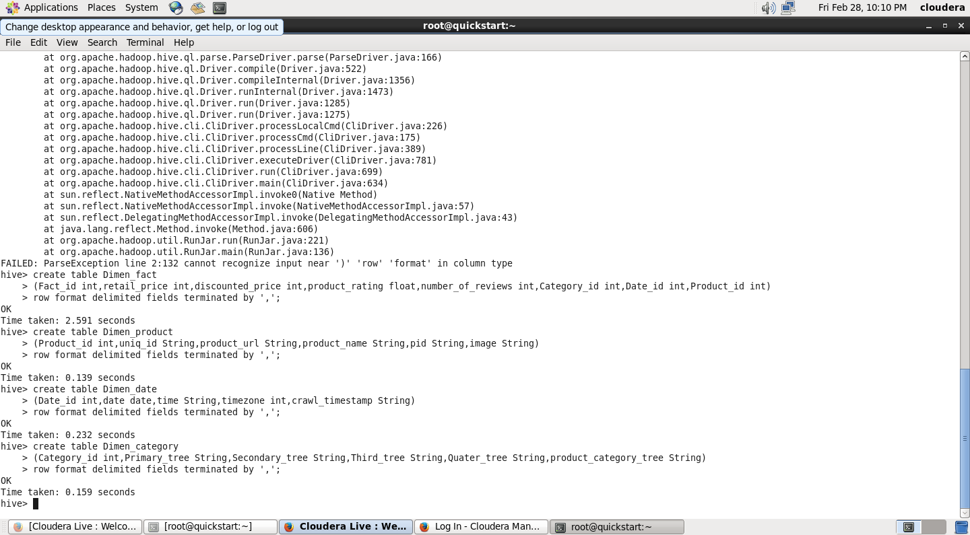
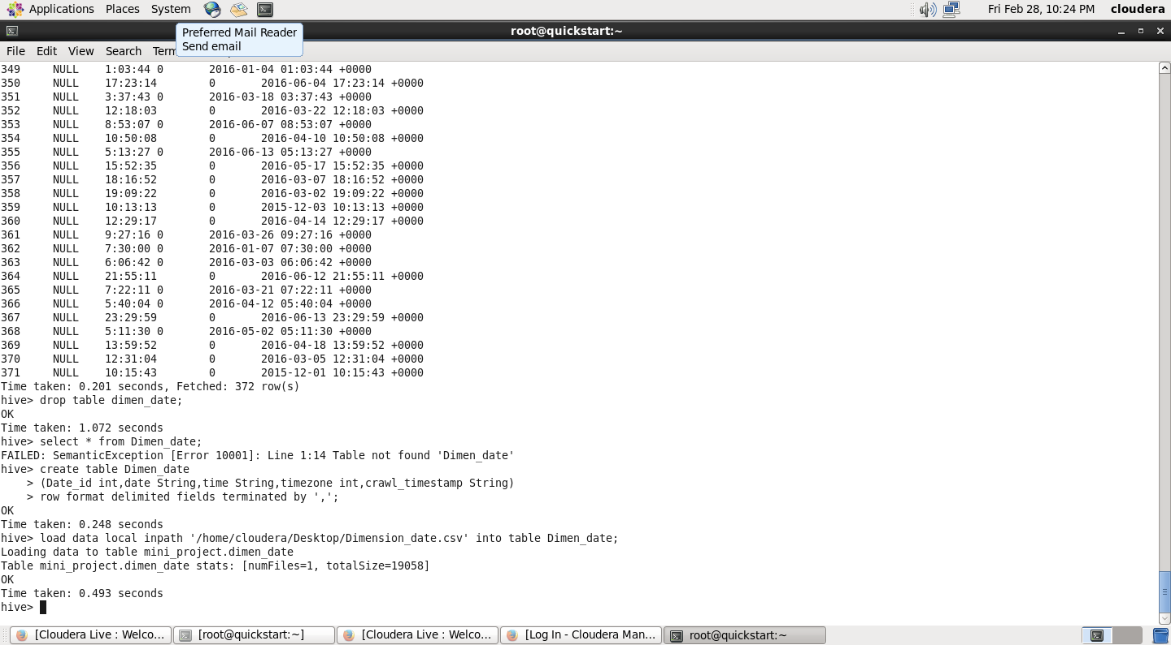
Creating tables in hive:

Slide 13
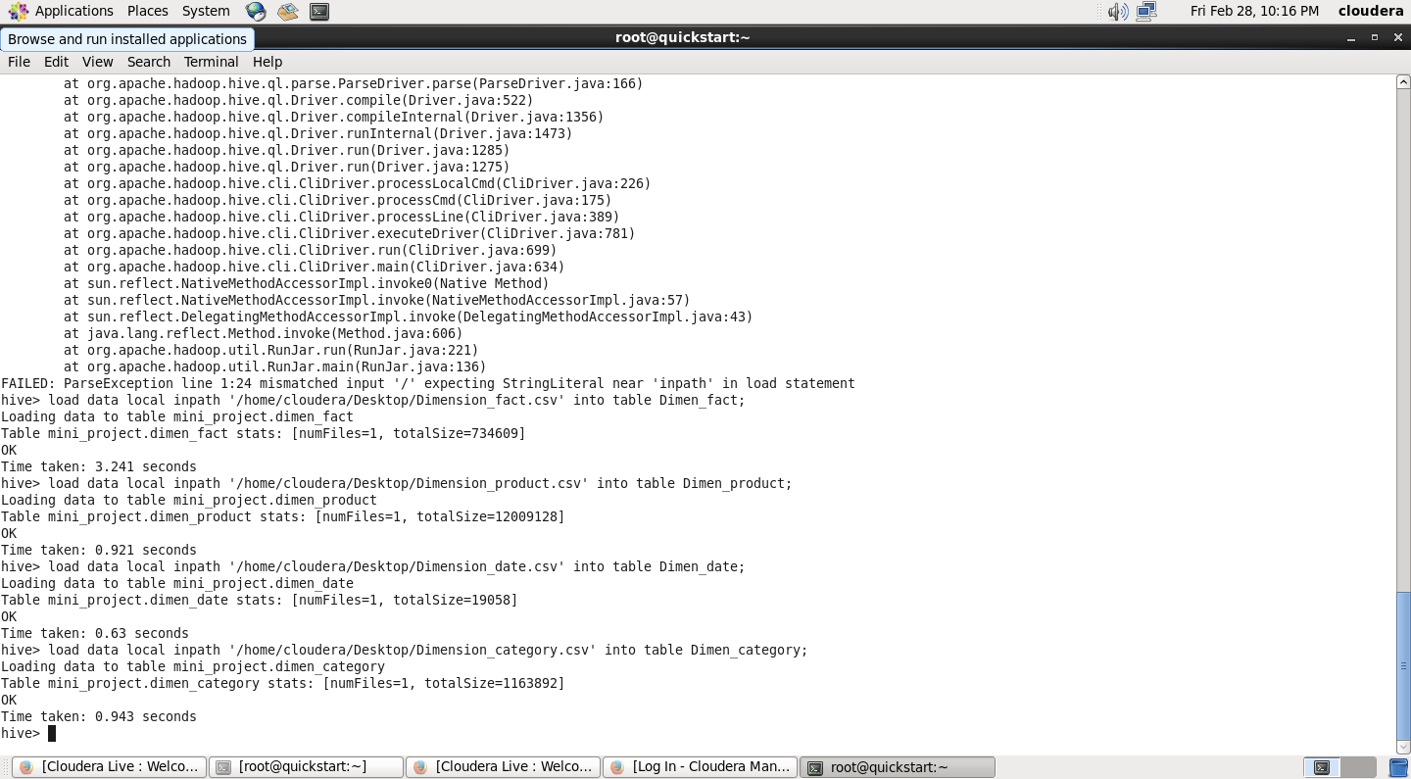
Loading data in hive:

Slide 14
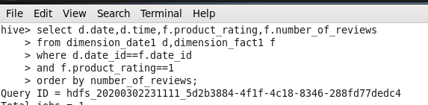
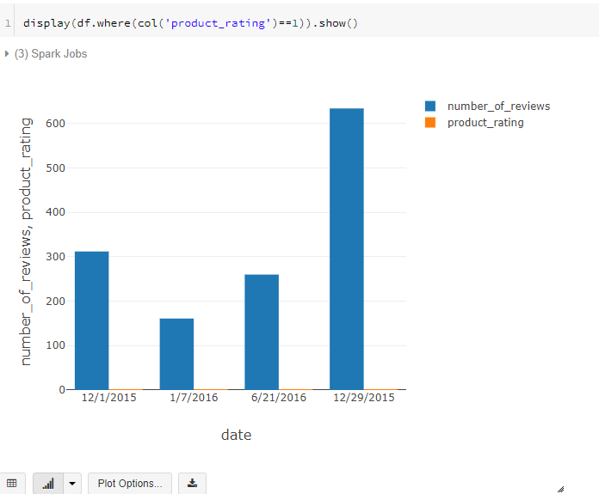
Analysis of data:
Product analysis based on rating and number of reviews

Slide 15

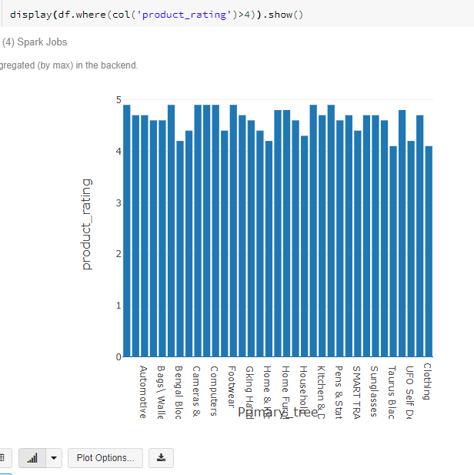
Product analysis based on product rating and primary tree

Slide 16

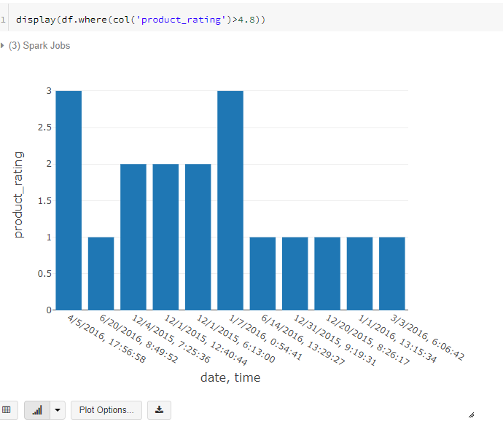
Product analysis based on product rating and date

Slide 17

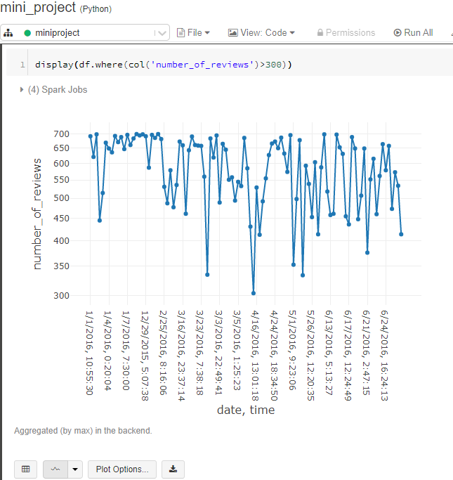
Product analysis based on number of reviews

Slide 18
Conclusion:
The Data modelling used is efficient enough to get a clear instance of data in all three perspective which are user, Flipkart and different products perspective. This dataset is a pre-crawled dataset, therefore lesser variation is found. Still a great vision of insights of Flipkart data can be analysed.

Slide 19


